Slide 1





Chengkai Li
Associate Professor and Associate Chair, CSE
Director, Innovative Database and Information Systems Research (IDIR) Lab
Ph.D. (University of Illinois at Urbana-Champaign, 2007)
idir.uta.edu
Areas: Big Data Intelligence and Data Science (Database, Data Mining, Web, Natural Language Processing)
Projects:
data-driven fact-checking, computational journalism (global leading position, well-known in both computing and professional fact-checking communities)
cybersecurity, fake-news detection
graph database usability, knowledge databases
Funding: $3M (including 4 major NSF grants), $1.6M as Project Lead
Media Coverage:
and many more
Achievements: paper awards at top conferences, HP Labs innovation research award, SXSW 2017 panelist, keynote/invited speaker at conferences, general/program chair/organizer of conferences, associate editor of journals

Slide 2
IDIR Students and Collaborators
Current students: 7 Ph.D., 3 M.S., 2 B.S.
Graduated students: 4 Ph.D., 18 M.S., 9 B.S.
Student internships: Amazon A9 Labs, AT&T, Google, HP Labs, Huawei, IBM Research India, NEC Labs, Qatar Computing Research Institute (QCRI), RedHat
First-employment after graduation: Tenure-track assistant professor : University of Mississippi; Researchers: Huawei US R&D Center, IBM Research India; Software engineers: Akamai, Amazon, Ambit Energy, Capital One, Cerner, Copper Labs, Dematic, Electronic Arts (EA) , Google, Microsoft, Pivotal
Current & past collaborators: Duke, George Washington U., Google, HP Labs, Mississippi, Stanford, UCSB, UTD, Chinese Academy of Sciences, Hong Kong Baptist University, Nanjing University, Nanyang Technological University, University of Technology Sydney

Slide 3

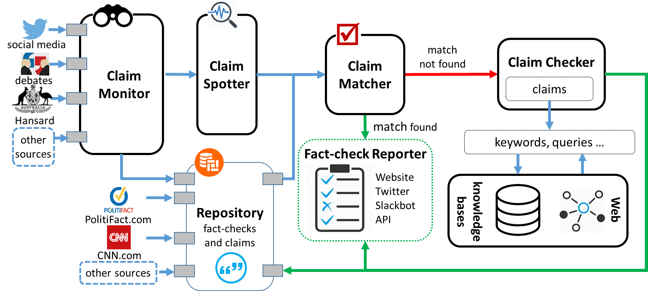
The First-ever End-to-end Fact-checking System
idir.uta.edu/claimbuster

Slide 4

Exceptional Fact Finding
Excellent Demo Award
FactWatcher (idir.uta.edu/factwatcher): Discovering and monitoring number-based facts pertinent to real-world events (sports, transportation, crime, weather, finance, social media)
Situational Facts: “No other player scored more pts and reb against DAL than Jordan.”
One-of-the-Few: “Jordan scored 10 pts & 10 reb. Only 3 others have similar performance.”
Prominent Streaks: “The Nikkei 225 closed below 10000 for the 12th consecutive week, the longest such streak since June 2009.”
Maverick: Framework and algorithms for discovering non-numeric exceptional facts about entities in knowledge graphs
Promoting entities: “Denzel Washington followed Sidney Poitier as only the second black to win the Best Actor award.”
Identifying data errors: “Hillary Clinton becomes first female presidential nominee.”

Slide 5
Tackling Graph Database Usability Challenges
Challenges
Large, complex and schema-less graphs capturing millions of entities and billions of relationships between entities.
Requires substantial understanding of schema and data and complex data cleaning and pre-processing, before one can fetch information or gain insights from data.
Objectives
Make it easy to understand, query, explore, and clean graph data.
Systems
GQBE (idir.uta.edu/gqbe): graph query by example
Orion (idir.uta.edu/orion): auto-suggestion for interactive graph query formulation
TableView: generating preview tables for knowledge graphs
Maverick: finding outliers and errors in graphs

